Slide 1
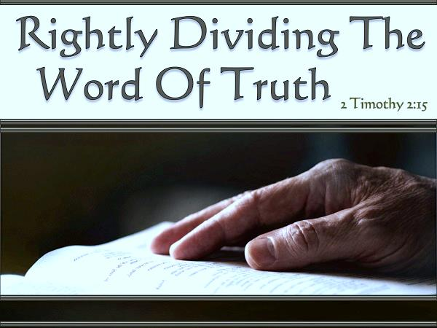


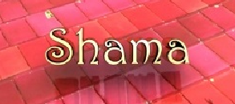

Or
By Todd Aurit & Colorado Study Club
Notes:
Begin May 4/21 11 AM … Final copy done midnight May 22/21
Recorded may 23 pentecost with charlene, todd, jeanette, tim – 2 hrs. … well rec’d … place on website under “other teachers”

Slide 2
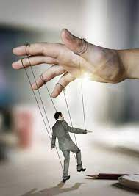
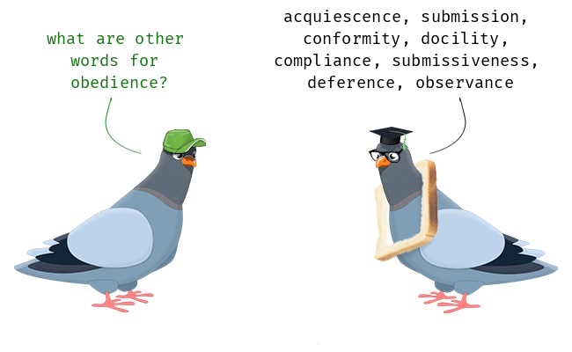
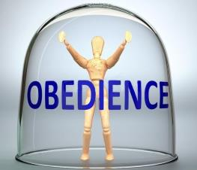
What is ?
This?
Or
This?
2
Notes:
Begin May 4/21 11 AM

Slide 3

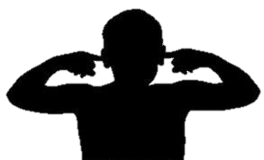
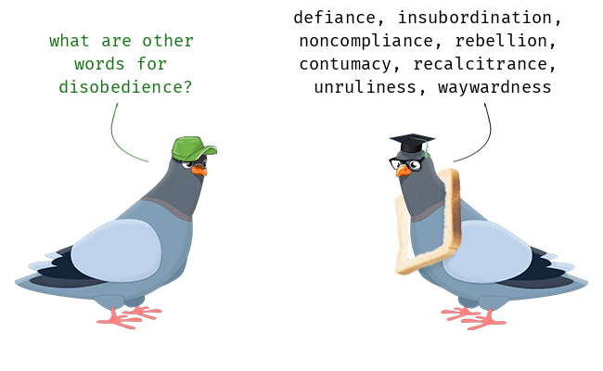


What is ?
This?
or
This?
3
Notes:
Begin May 4/21 11 AM

Slide 4
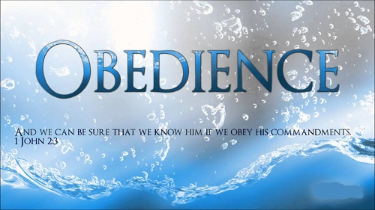


Why should we show our
To the word of our one true creator ~ “Yahuah” our Elohim?
Or, can we get away with disobedience once in a while?
4

Slide 5


The only true way to search the Scriptures is to lay down every prejudice, every preconceived opinion,
at the very door of investigation, and then enter into the work with an eye single to the glory of Yahuah, with an understanding open to conviction, and a
heart softened to believe what Yahuah says to you.
5
All Scriptures from “The Scriptures 2009” unless otherwise noted.

Slide 6

Requirements for Scripture Studies
Learn to read enough content of the Scriptures very carefully.
Learn to read in context.
Learn to pay attention to grammar.
Learn to keep the “timing” events of Bible stories in order, according to the order of the verses.
Learn to use your logic and common sense more than ever before.
Remember: There is not one idle word in Scripture – everything
is written according to Divine Inspiration, and for the
edification of truth.
Learn how to use the Hebrew (and Greek) definitions properly, and consistently.
Expect (and insist) to establish at least
2-3 firm witnesses to establish any new truth.
Expect the “traditions” around Scripture to be clearly exposed for the darkness they represent.
Understand there is a fuller restoration of all “Truths” according to the Torah, the Prophets, and our Malkiy-tsedeq Priest.
6

Slide 7

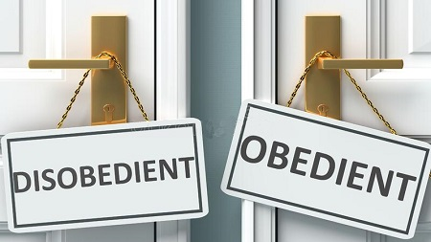
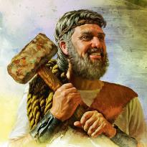
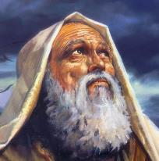
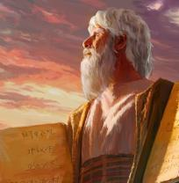
Questions!
Obedience leads to what?
Disobedience leads to what?
Where did disobedience begin?
What do the Scriptures say about Noah, Abraham and Mosheh?
What does Yahuah say?
7

Slide 8
Noah ~ was he righteous?
Gen 6:8, 9, 22 But Noah found grace in the eyes of Yahuah. 9 … Noah was
a righteous man and perfect in his generations. Noah walked with Elohim.
And Noah did according to all that Elohim commanded him, so he did.
Abraham ~ was he righteous?
Gen 26:4-5 And I shall increase your seed like the stars of the heavens, and
I shall give all these lands to your seed. And in your seed all the nations of
the earth shall be blessed, 5 because Abraham obeyed my voice, and guarded
My Charge: My commands, My laws, and My Torah.
Mosheh ~ was he righteous?
Num 12:7 [& Heb 3:2] “Not so with My servant Moses, he is trustworthy in all mine house.” Remember Yahuah spoke to Moses “face to face” [Exo 33:11]; was the only person buried by Yahuah [Deut 34:5-6]; stood with Elijah at the transfiguration [Luke 9-30-31] & much more.
8

Slide 9
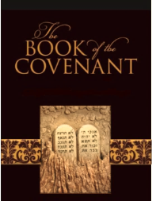

How does being obedient align with following Yahuah’s
Blood Ratified covenant found between Gen 1:1 to Exo 24:11?
Is it a “Salvational issue”
to be obedient to all the Covenant given to us by our Maker ~ THE Creator of “ALL” ~ our Ruach Yahuah and our Elohim?
Is one path better?
9

Slide 10
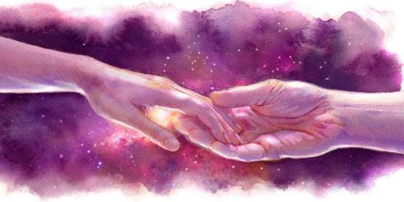
Being Prepared for our “Bridegroom”
Greek word definitions:
“oida” means “intuitive knowledge”
“ginosko” means “objective knowledge” or “required knowledge.”
Rev 3:3 Remember, then, how you have received and heard. And watch and repent. Rev 16:15 Blessed is he who is staying awake and guarding his garments, lest he walk naked and they see his shame.
This is how Yahuah’s Covenant aligns with obedience – with a guard. We are to watch and guard Yahuah’s Covenant ~ not man’s “times or traditions.”
10

Slide 11
Matthew 7:13-14 & 25:1-13
When it comes to being obedient, these are our favorite verses in Scripture to go to, to understand TRUTH versus “tradition.” (Quote from Todd & friends.)
Matt 7:13-14 Enter in through the narrow gate! Because the gate is wide – and the way is broad – that leads to destruction, and there are many who enter in through it. 14 Because the gate is narrow and the way is hard pressed which leads to life, and there are few who find it.
Matt 25:1-13 [Parable of Ten Virgins: 5 wise with extra oil; 5 foolish without extra oil.]
Yahusha used many parables to speak to His disciples, as in:
Matt 13:34-35 Yahusha said all this to the crowds in parables; and He did not speak to them without a parable, 35 so that what was spoken by the prophet might be filled, saying, "I shall open My mouth in parables; I shall pour forth what has been hidden from the foundation of the world."

Slide 12
Prophecy of Isaiah Fulfilled
The prophecy of Isaiah 6:9 is fulfilled in:
Matt 13:13-15 Because of this I speak to them in parables, because seeing they do not see, and hearing they do not hear, nor do they understand. 14 And in them the prophecy of Yeshayahu [Isaiah] is fulfilled, which says: 'Hearing you shall hear and by no means shall understand, and seeing you shall see and by no means perceive; 15 for the heart of this people has become thickened, and their ears are hard of hearing, and their eyes they have closed, lest they should see with their eyes and hear with their ears, lest they should understand with their heart, and turn back, and I heal them.’
Jer 33:3 Call unto Me, and I shall answer you, and show you great and inaccessible matters, which you have not known.
Isa 30:20, 21 Though Yahuah gave you bread of adversity and water of affliction, your Teacher shall no longer be hidden. But your eyes shall see your Teacher, 21 and your ears hear a word behind you saying, “This is the Way walk in it,” whenever you turn to the right, or whenever you turn to the left.”

Slide 13
Dictionary Definitions: Webster’s
Obedience 1a: an act or instance of obeying; 1b: the quality or state of being obedient. Obedient, submissive to the restraint or command or authority, “Willing to obey” [Emp. Supplied].
Obey out of Love for Yahuah, Scriptural Love is “Qualified.”
Obeisance 1a: movement of the body made in token of respect or submission: bow. 2: acknowledgment of another’s superiority or importance: HOMAGE.
Obey, Obeyed, Obeying 1: to follow the commands or guidance of; 2: to confirm to or comply with an order, to behave obediently.

Slide 14
Dictionary Definitions: Strong’s
Obey ~ Obeyed ~ Obeyeth ~ Obeying ~ Obedience ~ H8085 [1160x] shama`; a primitive root; to hear intelligently (often with implication of attention, obedience, etc.; causatively, to tell, etc.)
Obeisance H7812 [172x] shachah; a primitive root; to depress, i.e. prostrate (especially reflexive, in homage to royalty or God [Elohim]).
Note: For the Greek word “obedience” notice the first 3 definitions differ from G5293!
Obedience G5218 hupakoe; from G5219; attentive hearkening, i.e. (by implication) compliance
or submission.
Obedience G5219 hupakouo; from G5259 and G191; to hear under (as a subordinate),
i.e. to listen attentively; by implication, to heed or conform to a command or authority:
KJV - hearken, be obedient to, obey.
Obedience G5255 hupekoos; from G5219; attentively listening, i.e. (by implication) submissive: KJV - obedient.
Obedience G5293 [1x] hupotasso; from G5259 and G5021; to subordinate; reflexively, to obey.

Slide 15
Strong’s Comparison of Hebrew Obedient
Note: In Strong’s the word Obedient is found
8x in Hebrew (H8085) – only one number is used.
Obedient H8085 shama`;
a primitive root; to hear intelligently (often with implication of attention, obedience, etc.; causatively, to tell, etc.)
Note: H8085 is used 1160x using other words.
8 Hebrew Scriptures for “Obedient” KJV
Exo 24:7 And he took the Book of the Covenant, and read in the audience of the people: and they said, All that Yahuah hath said will we do, and be obedient.
Num 27:20 And thou shalt put some of thine honour upon him, that all the congregation of the children of Israel may be obedient.
Deut 4:30 When thou art in tribulation … if thou turn to Yahuah thy Elohim, and shalt be obedient unto his voice; … he will not forsake thee …
Deut 8:20 … so shall ye perish; because ye would not be obedient unto the voice of Yahuah your Elohim.
2 Sam 22:45 Strangers shall submit themselves unto me: as soon as they hear, they shall be obedient unto me.
Prov 25:12 As an earring of gold, and an ornament of fine gold, so is a wise reprover upon an obedient ear.
Isa 1:19 If ye be willing and obedient, ye shall eat the good of the land:
Isa 42:24 … for they would not walk in His ways, neither were they obedient unto His law.

Slide 16
Strong’s Comparison of Hebrew Obeisance
Note: All KJV references for Obeisance are found only in
the Torah and the Prophets.
Obeisance H7812 [9x] shachah; a primitive root; to depress, i.e. prostrate (especially reflexive, in homage to royalty or God [Elohim]).
  In other words – homage and royalty to Yahuah – to worship, bow and bow down – in obeisance and reverence – to fall down, stoop or crouch.
Gen 37:7 … and, behold, your sheaves stood round about, and made obeisance to my sheaf.
Gen 37:9 And he dreamed yet another dream … the sun and the moon and the eleven stars made obeisance to me.
Gen 43:28 … Thy servant our father ... he is yet alive.
And they bowed down their heads, and made obeisance.
Exo 18:7 And Moses went out to meet his father in law, and did obeisance, and kissed him …
2 Sam 1:2 It came even to pass on the third day, that, behold, a man came out of the camp from Saul … when he came to David, that he fell to the earth, and did obeisance.
2 Sam 14:4 And when the woman of Tekoah spake to the king, she fell on her face to the ground, and did obeisance …
2 Sam 15:5 And it was so, that when any man came nigh to him [Absalom] to do him obeisance… he put forth his hand …
1 Kings 1:16 And Bath-sheba bowed, and did obeisance unto [David] the king.
2 Chron 24:17 Now after the death of Jehoiada came the princes of Judah, and made obeisance to the king.

Slide 17
Strong’s Comparison of Greek Obedient
8 Greek Scriptures for “Obedient” KJV
Acts 6:7 [G5219] And the word of Elohim increased; … disciples multiplied … and a great company of the priests were obedient to the faith.
Rom 15:18 [G5218] For I will not dare to speak of any of those things which Yahusha hath not wrought by me, to make the Gentiles obedient,
by word and deed.
2 Cor 2:9 [G5255] For to this end also did I write, that I might know the proof of you, whether ye be obedient in all things.
Eph 6:5 [G5219] Servants, be obedient to them that are your masters …
Phil 2:8 [G5255] And being found in fashion as a man, he humbled himself, and became obedient unto death, even the death of the cross.
Titus 2:5, 9 [G5293] To be discreet, chaste, keepers at home, good, obedient to their own husbands, that the word of Elohim be not blasphemed. 9 Exhort servants to be obedient unto their own masters …
1 Peter 1:14 [G5218] As obedient children, not fashioning yourselves according to the former lusts in your ignorance:
Note: In Strong’s the word Obedient is found
8x in the [NT] Restored Covenant in Greek using 4 numbers; (G5219; G5218; G5255; G5293*).
*Obedience G5293 also uses the same Strong’s number as “obedient” [but used only 1x time in 1 Cor 14:34 in a much different context].
Note: 1 Cor 14:34 (G5293/obedience) will be addressed separately.

Slide 18
Greek Comparison of Obedience: G5218 & G5293
Obedience is found 12 times in the NT Restored Covenant like this:
Obedience G5218 [11x] hupakoe; from G5219; attentive hearkening, i.e. (by implication) compliance or submission.
  G5218 note: all references are found in the Restored Covenant
  [to be reviewed on the next slide for content].
  [Rom 1:5. 5:19; 6:16; 16:19, 26; 2 Cor 7:15; 10:5-6; Phil 21; Heb 5:8].
Obedience G5293 [1x] hupotasso; from G5259 and G5021;
to [1] subordinate; [2] reflexively, to obey.
G5293 note: this is the only definition found in one reference that does not fit the context for this study on obedience including the following vss.
Note: 1 Cor 14:34 (G5293/obedience) will be reviewed soon.

Slide 19
Greek Context Comparison for Obedience
G5218
Rom 1:5 By whom we have received grace
and apostleship, for obedience to the faith among all nations, for his name:
Rom 5:19 For as by one man's disobedience many were made sinners, so by the obedience of one shall many be made righteous.
Rom 6:16, 19, 26 Know ye not, that to
whom ye yield yourselves servants to obey,
his servants ye are to whom ye obey; whether of sin unto death, or of obedience unto righteousness? 19 For your obedience is come abroad unto all men. I am glad therefore on your behalf: but yet I would have you wise unto that which is good, and simple concerning evil. 26 But now is made manifest, and by the scriptures of the prophets, according to the commandment of the everlasting Elohim, made known to all nations for the obedience of faith.
2 Cor 7:15 And his inward affection is more abundant
toward you, whilst he remembereth the obedience of
you all, how with fear and trembling ye received him.
2 Cor 10:5-6 Casting down imaginations, … and bringing
into captivity every thought to the obedience of Yahusha;
6 And having in a readiness to revenge all disobedience, when your obedience is fulfilled.
Phil 21 Having confidence in thy obedience I wrote unto
thee, knowing that thou wilt also do more than I say.
Heb 5:8 Though he were a Son, yet learned he obedience
by the things which he suffered;
1 Pet 1:2 Elect according to the foreknowledge of Elohim the Father, through sanctification of the Ruach, unto obedience
and sprinkling of the blood of Yahusha ha Mashiach …
G5293
1 Cor 14:34 Let your women keep silence in the churches:
for it is not permitted unto them to speak; but they are commanded
to be under obedience, [obedient] as also saith the law.
19

Slide 20
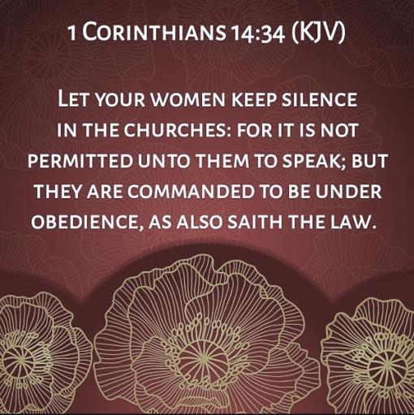

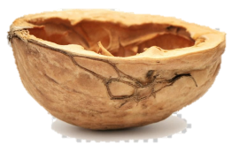
Time to Address 1 Cor 14:34 & Obedience
This is a very controversial topic, but let’s have a “nutshell” investigation at this point in the study.
20

Slide 21
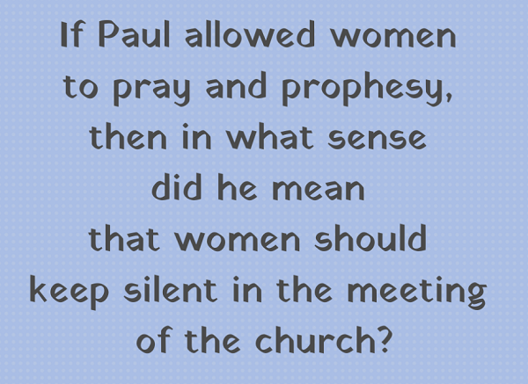
G5293 & 1 Cor 14:34 Context for Obedience
Because the usage of the word “obedience” in this passage is very different from the other 11 Scriptures, it is necessary to check the context of the content in this chapter. Let’s see if we can understand what Paul was really trying to portray.
21

Slide 22

1st ~ Let’s check the KJV again to see if any words
need to be carefully eliminated.
1 Cor 14:34 Let your women keep silence in the churches:
for it is not permitted unto them to speak; but they are commanded
to be under obedience, [obedient] as also saith the law. KJV
Obedience G5293 [1x] hupotasso; from G5259 and G5021;
to [1] subordinate; [2] reflexively, to obey.
Note the definitions for G5293 – and the placement of “obey.”
Next: note how this verse reads using Strong’s 1st definition.
22

Slide 23
2nd ~ Let’s eliminate the added words and insert the 1st definition of “subordinate” that is suggested by Strong’s.
1 Cor 14:34 Let your women keep silence in the churches:
for it is not permitted unto them to speak; but to be under subordination, [{or} to be subordinate] as also saith the law. KJV
Obedience G5293 [1x] hupotasso; from G5259 and G5021;
to [1] subordinate; [2] reflexively, to obey.
Question: Does “subordinate” fit the context of this verse any better?
Maybe not! Why? Let’s check another source and see.
23

Slide 24
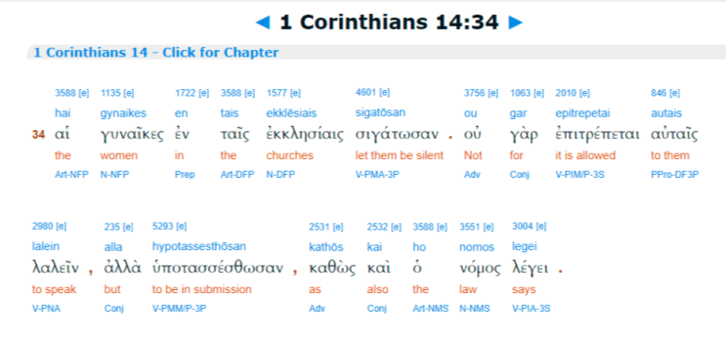
3rd ~ Let’s choose the suggestion from the Bible Hub Interlinear for the wording “to be in submission” meaning each one “submits themselves” as under the law.
1 Cor 14:34
Let your women keep silence in the churches:
for it is not permitted unto them to speak; but to be in submission,
as also the law says. KJV
Before we make a final decision, let’s check the context of the full passage.
24
Maybe not! Why? Let’s check another source and see.

Slide 25
1 Cor 14:26-35 – The Order of Assembly Meetings begins in vs 26:
26 How is it then, brethren? When ye come together, everyone of you [1] hath a psalm, [2] hath a doctrine,
[3] hath a tongue, [4] hath a revelation, [5] hath an interpretation. Let all things be done unto edifying.
To Keep Order in the Assembly, if there is no one to interpret, the speaker is to keep silent.
27 If any man speak in a unknown tongue, let it be by two, or at the most by three, and that by course; and let one interpret.
28 But if there be no interpreter, let him keep silence in the church; and let him speak to himself, and to Elohim.
29 Let the prophets speak two or three, and let the other judge.
To Keep Order in the Assembly, those that prophesy should do so ‘one
by one’ to avoid confusion.
30 If any thing be revealed to another that sitteth by, let the first hold his peace.
31 For ye may all prophesy one by one, that all may learn, and all may
be comforted.
32 And the spirits of the prophets are subject to the prophets.
33 For Yahuah is not the author of confusion, but of peace, as in all churches of the saints.
To Keep Order in the Assembly, women that have questions for their husbands are to seek these answers
at home to avoid additional confusion to whoever
is speaking.
34 Let your women keep silence in the churches: for it is not permitted unto them to speak; but to be in submission, as also the law says.
35 And if they will learn any thing,
let them ask their husbands at home:
for it is a shame for women to speak in the church.
25

Slide 26
Why Would/Should Women Be Corrected?
Paul was speaking to the church at Corinth, of Greece. It was a place of extreme
pagan worship culture, and a constant influx of foreigners who participated in it all.
Paul won many converts there, yet it came with many questions and letters, etc. The Bible does not include the letters that Corinth wrote to Paul. We only see the letters Paul wrote to answer them. Therefore, much information is missing from “letter correspondence” and teachings that Paul would have given over many months.
Some of the women may have been reverting to the model of pagan worship, disrupting the service with their loud noises. Culturally, the only way women were allowed to participate was by wailing and making high-pitched cries called “ululations.”
Women practiced this for thousands of years, for both joy and for grief. Among pagans, the men ministered and offered sacrifices while the women provided the sound effects.
Paul now expected ALL to minister, but in an orderly way, without the chaos of their pagan past. Besides this he also encouraged women, as they were generally uneducated. He counseled them to ask their husbands at home (vs.35) to catch them
up if they desired to learn, and not interrupt with their many questions during the assembly to avoid confusion and disorder.
26

Slide 27
(Written By Two [2] Men: Loren Cunningham and David Hamilton)
Paul Corrects Three Groups as Clarified in
“Why Not Women”?
Many overlook the fact that this command does not stand alone. As we just read previously,
Paul also had similar corrective words to two other groups in the same chapter, in which
the context is about coming together for worship in an orderly manner.
Paul said “to be silent” to: 1) those who spoke in tongues (vs. 28);
2) to the prophet, (vs. 30); and
3) to the women (vs. 34).
In all three of these verses “be silent” had to do with taking turns,
listening to one another, and being self-controlled so everyone could
be strengthened and edified.
Women were in all three of these groups, as Paul already declared in vs. 26 that ”When you assemble, “everyone” (each one) has a hymn, or a word of instruction, a revelation, a tongue or an interpretation.” The word, “everyone” knew no gender limitations.
27

Slide 28
Bible Hub
Interlinear
Digging Deeper into History & Culture
“The Greek-speaking Jews who prepared a Greek version of the Hebrew Scriptures (the Septuagint) saw
a remarkable correlation between “silence” and “submission.” There are three places in Psalms where the Hebrew text speaks of being silent unto Yahuah. In each case…translators rendered this by the Greek verb meaning “to submit oneself.” The original implication is one of attentiveness and receptivity to Yahuah.” [From “I Suffer Not,” Kroeger and Kroeger, pgs. 75-76, referring to Psalms 37:7, 62:1, and 62:5.]
It seems applicable here, that Paul simply had in mind the Old Testament idea of “waiting on Yahuah,”
or of “humility towards Yahuah;” the very same thing being required of men. He was telling the women that they were accepted as full partners in the gospel, and given the privilege to minister. They had new freedom in Yahusha, however the same self-submission to Him, is expected from them as from the men.
28

Slide 29

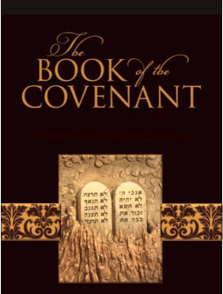

1 Cor 14:34 – Paul’s Conclusion in Comparison to Yahuah’s Required Obedience
The intent of this study is to emphasize
obedience to Yahuah’s commands.
The KJV reference to “obedience” in
1 Cor 14:34 has been grossly misleading in its translation. The instruction to be orderly in the assembly is not for “women only,”
nor is it referencing obedience towards others gathered at the assembly.
EVERYONE:
Let’s return to the real intent of this study.
29

Slide 30
Strong’s Comparison of Hebrew & Greek
Note: It’s time for definition comparisons of the words Obey – Obeyed – Obeying.
Obey (or Obedient)
H8085 [1160x] to hear intelligently with attention;
  shama` [40x using ‘obey’] to hear intelligently and to obey
H3349 [1x] to obey; a gathering of the obedient
H4928 [3x] a guard; obedient guard
G3980 [4x] to be persuaded by a ruler
G544 [16x] to willfully disbelieve & disobey
G3982 [56x] to obey by convincing argument; persuade
G5219 [21x] be obedient;
G5255 [3x] submissive due to intently listening
G5218 [15x] attentive hearkening through learned obedience
Time to Consider:
When concepts are mentioned numerous times, do you think
it is important to Yahuah that we
pay strict attention
to what His Word
is saying?
Especially if it is about obedience?!

Slide 31
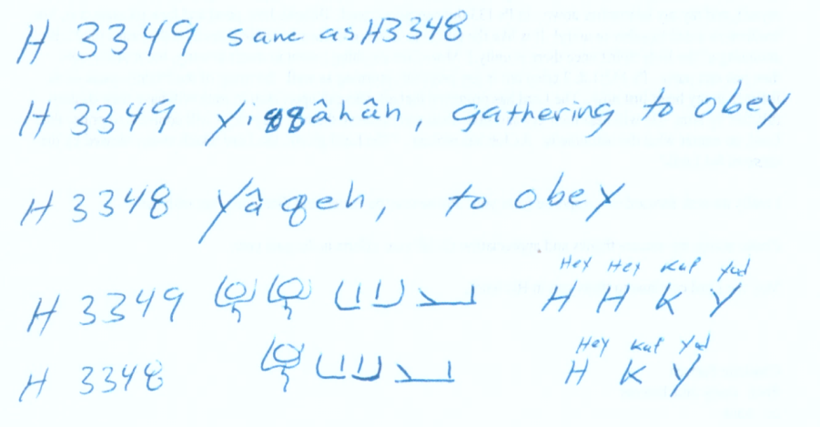
Paleo Comparison of H3349 & H3348
H3348 to obey H3349 a gathering of the obedient
Paleo Concept
Did you notice, that “those who obey” are in a “special gathering”?

Slide 32
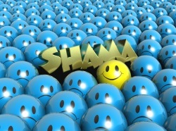
Strong’s Usage of Hebrew & Greek
Source | Language | Obeyed | Obeyedst | Obeyeth | Obeying | Obedience | Obeisance
Old Testament | H8085 [1160x] H7812 [172x] | 34 | 5 | 3 | 2 | -- | 9
New Testament | G5219 | 7 | 2 | 3 | 1 | 12 | --
Totals |  | 41 | 7 | 6 | 3 | 12 | 9
As you can easily see: H8085 <shama>
is the main Hebrew word for “Obedient.”
TO HEAR INTELLIGENTLY
(often with implication of attention, obedience)
Note: Calculations can vary depending on the translation that is being used.

Slide 33
Ancient Hebrew Lexicon Jeff A Benner
Obedient <verb> prim. Root; afraid, fear, dread, terribly, break, affright, oppress, prevail, terrified (Strong’s G206)
Obeisance <verb> BOW: to pay homage to another one by bowing low or getting on the knees with the face to the ground; KNV: worship, bow, obeisance, reverence, fall, stoop, crouch (Strong’s H7812 prim. root; H7812 shachah)
Obey <noun feminate> collection; KJV: gathering, obey.
(Strong’s H3349 from H3348; an unused root; to obey, obedient.)
6 Commands to be obedient and 4 great benefits of obedience: Joshua 1:6-9

Slide 34
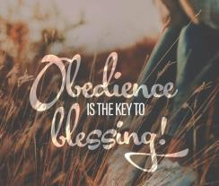
Commands & Blessings of Joshua 1:6-9
6 Be strong and of a good courage: for unto this people shalt thou divide for an inheritance the land, which I sware unto their fathers to give them.
7 Only be thou strong and very courageous, that thou mayest observe to do according to all the law, which Moses my servant commanded thee: turn not from it to the right hand or to the left, that thou mayest prosper whithersoever thou goest.
8 This Book of the Law shall not depart out of
thy mouth; but thou shalt meditate therein day and night, that thou mayest observe to do according to all that is written therein: for
then thou shalt make thy way prosperous,
and then thou shalt have good success.
9 Have not I commanded thee? Be strong and
of a good courage; be not afraid, neither be
thou dismayed: for Yahuah thy Elohim is with
thee whithersoever thou goest. KJV
This is the secret to obedience
[be strong and of good courage],
which in turn is the secret of success
(vs 8: a command & promise of Yahuah).
Psa 1:3-4 And he shall be like a tree planted by the rivers of water, that bringeth forth his fruit in his season;
his leaf also shall not wither; and whatsoever he doeth shall prosper.
4 The ungodly are not
so: but are like the
chaff which the wind
driveth away. KJV

Slide 35



Hebrew “shema/shama” in Other Lexicons
Shema/shama consists of sheen, mem, ayin; .
We will next investigate 6 references for “shema/shama.”
Etymological Dictionary of the Hebrew Language
Hebrew English Lexicon – J Parkhurst
Gesenius Lexicon (BLB)
Hebrew & English Lexicon of the 1st Covenant [1906]
Brown Driver Briggs Hebrew Lexicon
Koehler & Baumgartner

Slide 36
Shema/shama, just listen?
Or is there more?
What about the word – summon? Can we be “summoned” on something we listened to? Or is there an action required as a result of the listening?
Shema/shama – to listen and ACT ACCORDINGLY!
Will we see this concept in the definitions?
To be summoned - is to be held
accountable for actions taken.

Slide 37
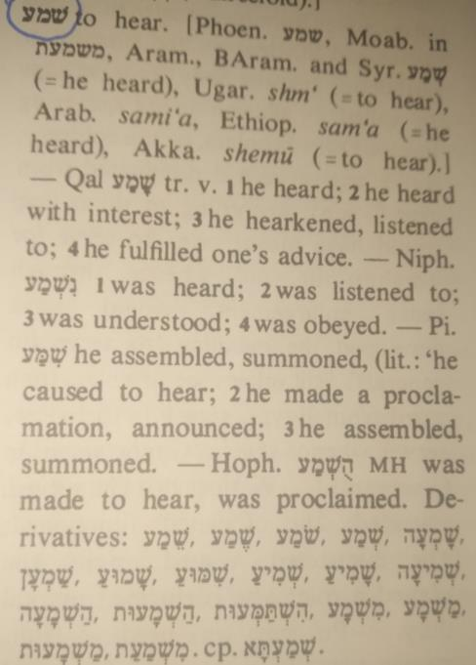
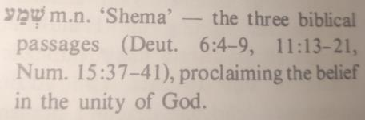
Etymological Dictionary
of the Hebrew
Shema/Shama
37

Slide 38
The Shema/shama of Yahuah
Deut 6:4-9
4 Hear, O Israel: Yahuah our Elohim, Yahuah is one!
5 And you shall love Yahuah your Elohim with all your heart, and with all your being,
and with all your might.
6 And these Words which I am commanding you today shall be in your heart,
7 and you shall impress them upon your children, and shall speak of them when you sit in your house,
and when you walk by the way, and when you lie down, and when you rise up,
8 and shall bind them as a sign on your hand, and they shall be as frontlets between your eyes.
9 And you shall write them on the doorposts of your house and on your gates.

Slide 39
Shema/shama = Blessings
of Obedience
Deut 11:13-21
13 And it shall come to pass, if ye shall hearken diligently unto my commandments which I command you this day, to love Yahuah your Elohim, and to serve him with all your heart and with all your soul,
14 That I will give you the rain of your land
in his due season, the first rain and the latter rain, that thou mayest gather in thy corn, and thy wine, and thine oil.
15 And I will send grass in thy fields for thy cattle, that thou mayest eat and be full.
16 Take heed to [guard] yourselves, that your heart be not deceived, and ye turn aside, and serve other gods, and worship them;
17 And then Yahuah’s wrath be kindled against you, and he shut up the heaven, that there be no rain, and that the land yield not her fruit; and lest ye perish quickly from off the good land which Yahuah giveth you.
18 Therefore shall ye lay up these my Words in your heart and in your soul, and bind them for a sign upon your hand, that they may be as frontlets between your eyes.
19 And ye shall teach them your children, speaking of them when thou sittest in thine house, and when thou walkest by the way, when thou liest down, and when thou risest up.
20 And thou shalt write them upon the door posts of thine house, and upon thy gates:
21 That your days may be multiplied, and the days of your children, in the land which Yahuah sware unto your fathers to
give them, as the days of heaven upon the earth. KJV

Slide 40
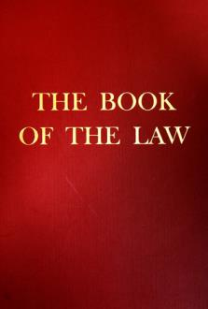
And just in case Israel
would not listen and obey …
Num 15:37-41 [extra Book of the Law commands that were temporary]
37 And Yahuah spake unto Moses, saying,
38 Speak unto the children of Israel, and bid them that they make them fringes in the borders of their garments throughout their generations, and that they put upon the
fringe of the borders a ribbon of blue:
39 And it shall be unto you for a fringe, that ye may look upon it, and remember all
the commandments of Yahuah, and do them; and that ye seek not after your own
heart and your own eyes, after which ye use to go a whoring:
40 That ye may remember, and do all my commandments, and be holy unto your Elohim.
41 I am Yahuah your Elohim, which brought you out of the land of Egypt, to be your Elohim: I am Yahuah your Elohim. KJV

Slide 41
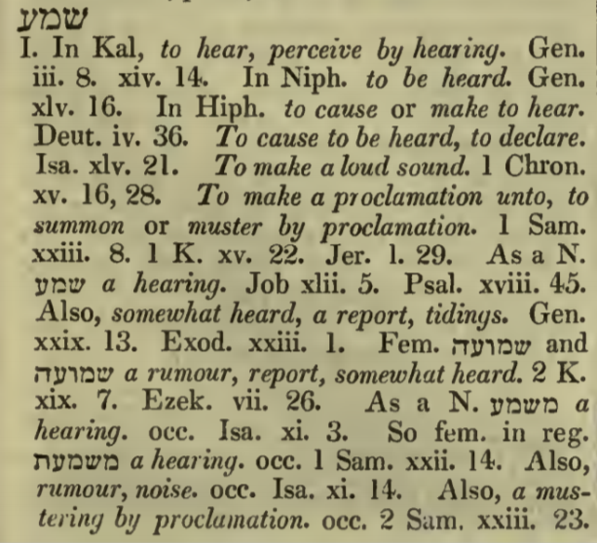
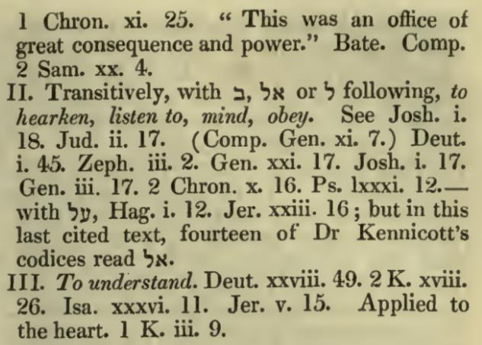
Hebrew English Lexicon - J Parkhurst 1762
Pg 611- Shema
41

Slide 42
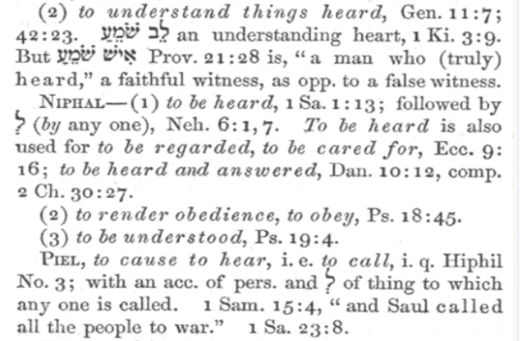
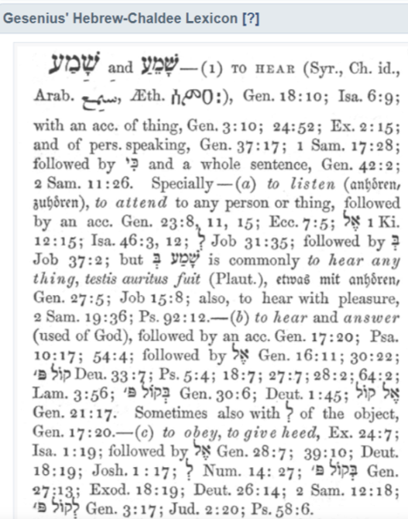
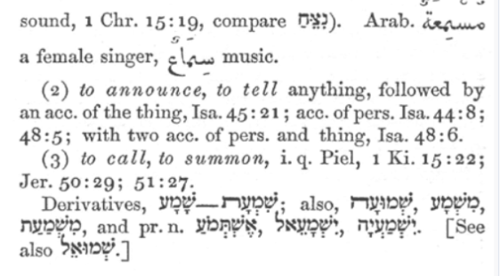
Gesenius Lexicon (BLB)
42

Slide 43
Gesenius Lexicon (BLB)
Shema
To be summoned, is to be positively required to declare the direct consequential results of one’s actions upon hearing certain commands and/or proclamations.
An undeniable call to action.
To sidestep, or avoid decisive action is not optional!
43

Slide 44
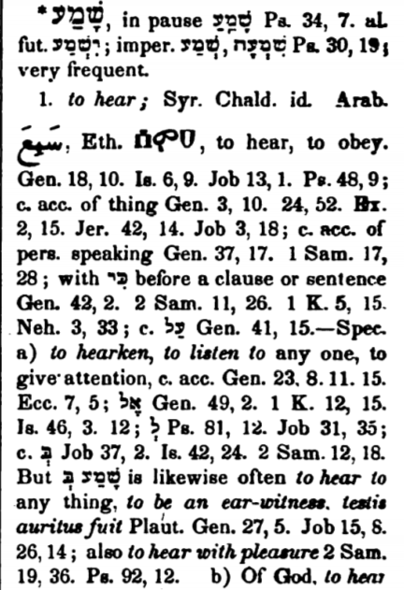
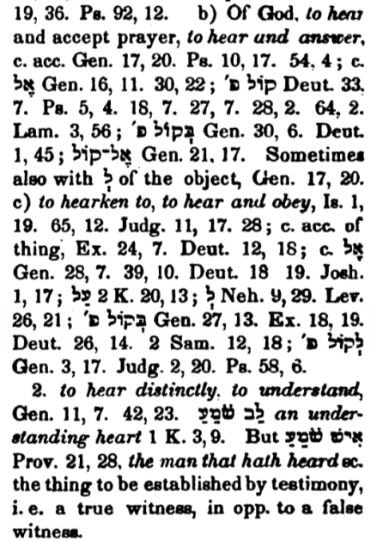
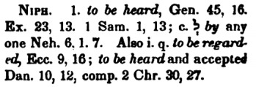
Based on William Gesenius – translated by Edward Robinson pg. 1105
Shema
44

Slide 45
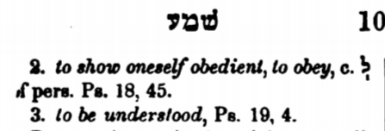

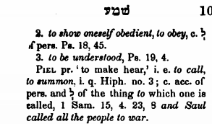
Based on William Gesenius – translated by Edward Robinson pg 1106
2nd page
Shema
Note:
to show yourself obedient –
is to
produce a positive action.
(obedience required)
Shema – a call to physical duty.
45

Slide 46
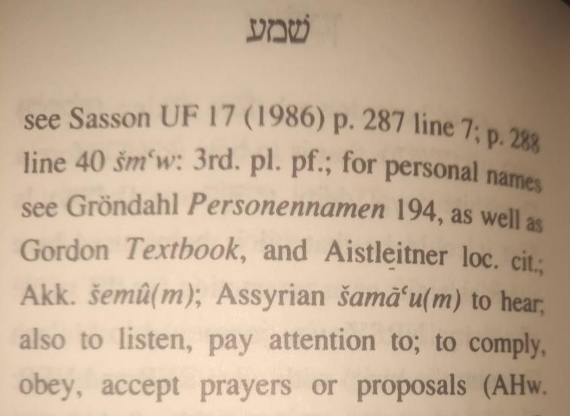
Lexicon of - Koehler & Baumgartner
Shema
To COMPLY, to a positive notion, is to take decisive action,
both psychological
AND PHYSICAL!
To Shema, requires action, otherwise Shema will not be accomplished!
46

Slide 47
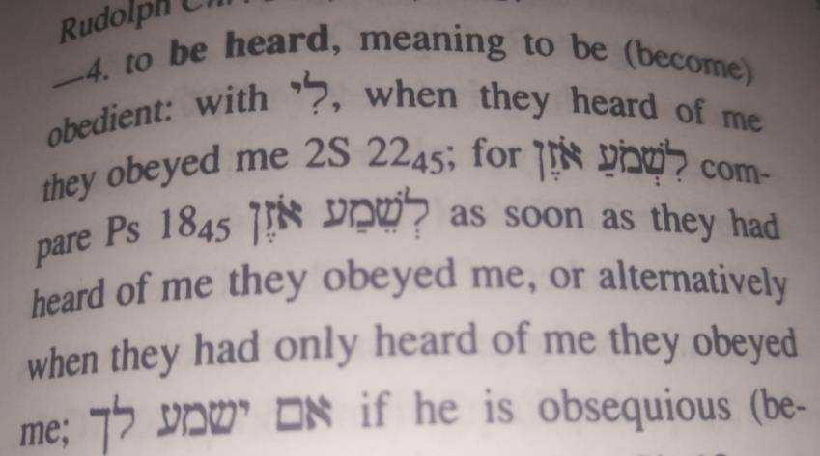
Lexicon of - Koehler & Baumgartner
Shema
Hearing, MUST BE FOLLOWED THROUGH with Obedience.
47

Slide 48
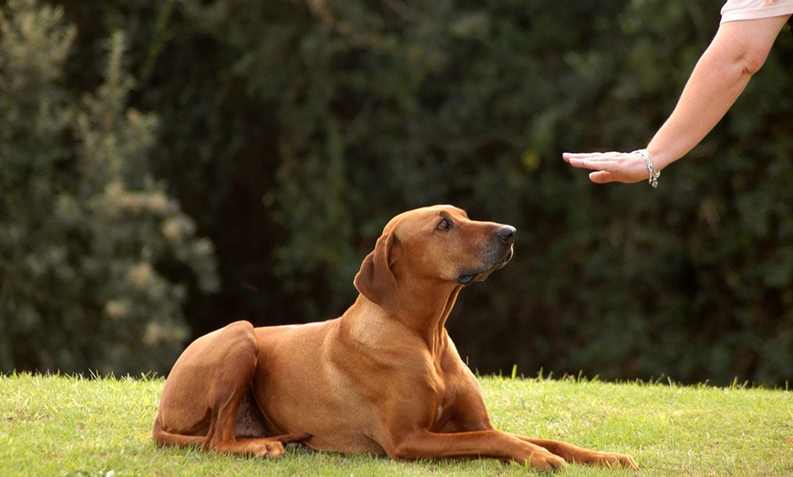
Why is it so important to be obedient?
Can’t we decide to be obedient
just before the end of time?
48

Slide 49



Yahusha Calls us to obey
Important Reasons to be Obedient Now
In Yahusha, we find the perfect model of obedience. As His disciples, we follow
His example as well as His commands. Our motivation for obedience is love.
John 14:15, 21 If you love Me, you shall guard my commandments. He who possesses
My commands and guards them, it is he who loves Me. And he who loves Me shall be
loved by My Father, and I shall love him and manifest Myself to him. (TS2009)
Obedience is an act of worship
While the Scriptures place a strong emphasis on obedience, it's critical to remember that believers are not justified (made righteous) by obedience. Salvation is a free gift of Yahuah. True obedience flows from a heart of gratitude for the grace we have received from Yahusha and our restoration to Him.
Rom 12:1 I call upon you, therefore, brothers, through the compassion of Elohim, to present your
bodies a living offering – set-apart, well-pleasing to Elohim – your reasonable worship. (TS2009)
49

Slide 50

Yahusha rewards obedience
Over and over again we read in the Scriptures that Yahuah blesses and rewards obedience.
Gen 22:18 "And in your seed all nations of the earth shall be blessed, because you have
obeyed My voice." (TS2009)
Luke 11:28 But He [Yahusha] said, “Blessed rather are those hearing the Word of Elohim and watching over it.” (TS2009)
But don’t just listen to Yahuah’s Word. You must do what it says – that’s called “shama.” What good is it to “listen” and not “obey”? When you look carefully into the perfect law that sets you free, and when you do what it says and don’t forget what you heard, then Yahuah can bless you for doing it.
James 1:22-25 And become doers of the Word, and not hearers only, deceiving yourselves. 23 Because if anyone is a hearer of the Word and not a doer, he is like a man who looks at his natural face in a mirror, 24 for he looks at himself, and goes away, and immediately forgets what he was like. 25 But he that looked into the perfect Torah, that of freedom, and continues in it, not becoming
a hearer that forgets, but a doer of work, this one shall be blessed in his doing of the Torah. (TS2009)
50

Slide 51


Obedience to Yahuah proves our love
The books of 1st & 2nd John clearly explain that obedience to Yahuah demonstrates our love for Him.
Loving Yahuah implies following his commands.
1 John 5:2–3 By this we know that we love the children of Elohim, when we love Elohim and guard His commands. 3 For this is the love for Elohim, that we guard His commands, and His commands are not heavy.
2 John 6 And this is the love, that we walk according to His commands. This is the command, that as you have heard from the beginning, you should walk in it. (TS2009)
Obedience to Yahuah demonstrates Faith
When we obey Yahuah, we show our trust and faith in him:
1 John 2:3–6 And by this we know that we know Him, if we guard His commands. 4 The one who says, “I know Him,” and does not guard His commands, is a liar, and the truth is not in him. 5 But whoever guards His Word, truly the love of Elohim has been perfected in him. By this we know that we are in Him. 6 The one who says he stays in Him ought himself also to walk, even as He walked. (TS2009)

Slide 52


Obedience is better than sacrifice
The phrase "obedience is better than sacrifice," has perplexed many. It can only be understood from an
Old Testament perspective. The law required the Israelite people to offer sacrifices to Yahuah, but those sacrifices and offerings were never intended to take the place of obedience.
1 Sam 15:22–23a Then Samuel said, “Does Yahuah delight in ascending offerings and slaughterings, as in obeying the voice of Yahuah? Look, to obey is better than a slaughtering, to heed is better than the fat of rams. 23 For rebellion is as the sin of divination, and stubbornness is as wickedness and idolatry.” (TS2009)
Disobedience leads to sin & death
The disobedience of Adam brought sin and death into the world. This is the basis of the term "original sin." But Yahusha's perfect obedience restores fellowship with Yahuah for everyone who believes in Him.
Rom 5:19 For as through the disobedience of one man [Adam's] many were made sinners, so also
through the obedience of the One many shall be made righteous.
1 Cor 15:22 For as all in Adam die, so also all shall be made alive in Messiah. (TS2009)

Slide 53

Through obedience, we experience
the blessings of set-apart living
Only Yahusha is perfect, therefore, only He could walk in sinless, perfect obedience. But as we allow Ruach Elohim to transform us from within, we grow in holiness. This is the process of sanctification, which can also be described as spiritual growth from day to day. The more we read Yahuah's Word, spend time with Him, and allow His Ruach to change us from within, the more we grow in obedience and holiness.
Psalm 119:1–8 Blessed are the perfect in the way, who walk in the Torah of Yahuah! 2 Blessed are those who observe His witnesses, who seek Him with all the heart! 3 Yes, they shall do no unrighteousness;
they shall walk in His ways. 4 You have commanded us to guard Your orders diligently.
5 Oh, that my ways were established to guard Your laws! 6 Then I would not be ashamed,
when I look into all Your commands. 7 I thank You with uprightness of heart, when I learn
the right-rulings of Your righteousness. 8 I guard Your laws; oh, do not leave me entirely! (TS2009)
2 Cor 7:1 Having, then, these promises, beloved, let us cleanse ourselves from all
defilement of the flesh and spirit, perfecting set-apartness in the fear of Elohim. (TS2009)
The verse above says, "Let us work toward complete set-apartness."
We don't learn obedience overnight; it's a lifelong process that we pursue by making it our daily goal.

Slide 54
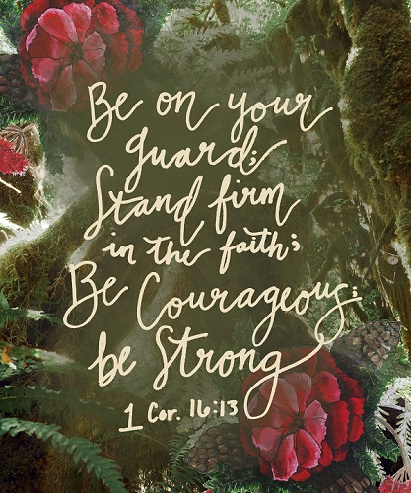
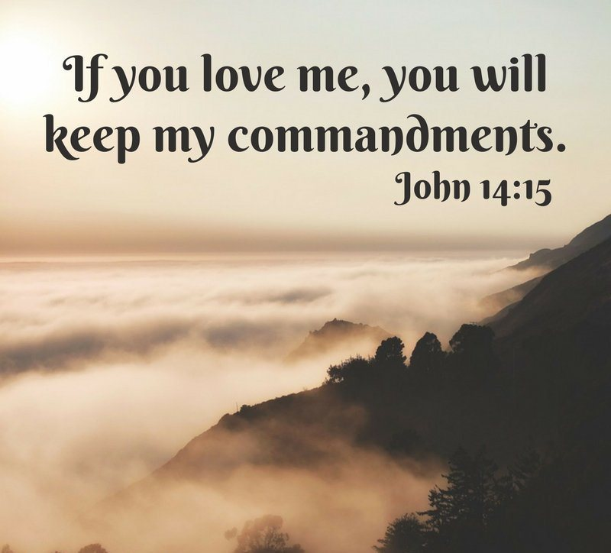
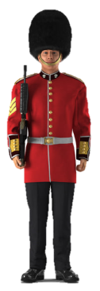

Did you notice how many times the word “guard” was used for “keep”?
Usually the word “keep” is used like this:
In John 14:15, doesn’t “keep” mean to “keep holy/qodesh/set-apart”?

Slide 55
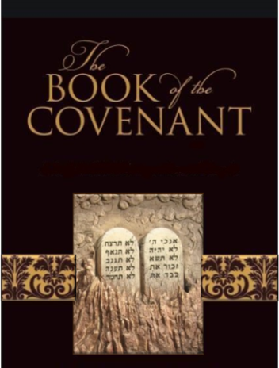
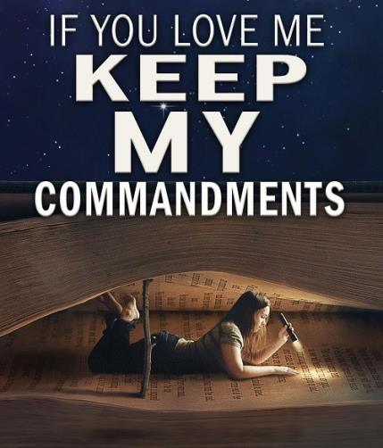

What is the difference between “Keep” the commandments and “guard” the commandments?
Deut 6:17 Ye shall diligently keep the commandments of Yahuah your Elohim,
and his testimonies, and his statutes, which he hath commanded thee. KJV
“keep” H8104 shamar (shaw-mar');
a primitive root; properly, to hedge about (as with thorns), i.e. guard; generally, to protect, attend to, etc.

Slide 56
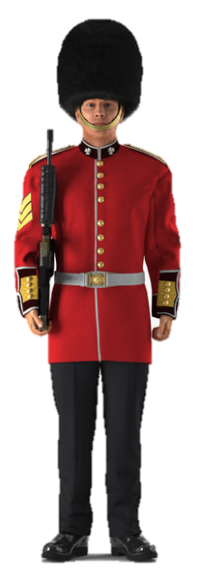
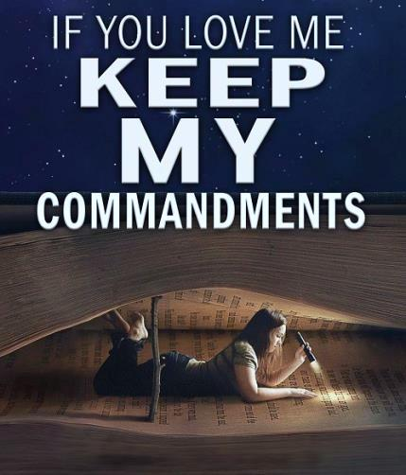
What about the word “keep” in
the [nt] restored covenant?
“keep” G5083 tereo; from teros
(a watch; perhaps akin to G2334);
to guard (from loss or injury,
properly, by keeping the eye upon.)
Guard: to keep, preserve, defend.
Webster’s 1828
John 14:15

Slide 57
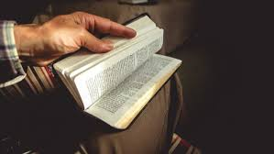
When it comes to yahuah’s instructions we are admonished TO understand them and
“obey them” continually!
GUARD
John 14:15

Slide 58
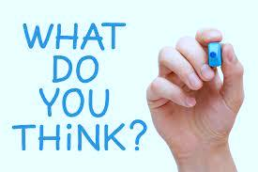

SHALL WE GUARD THE COVENANT FROM:
Being tampered with?
Adding & taking away?
Traditional counterfeits?
Compromise?
Being lost?
Being ignored?
Being misrepresented?
GUARD

Slide 59
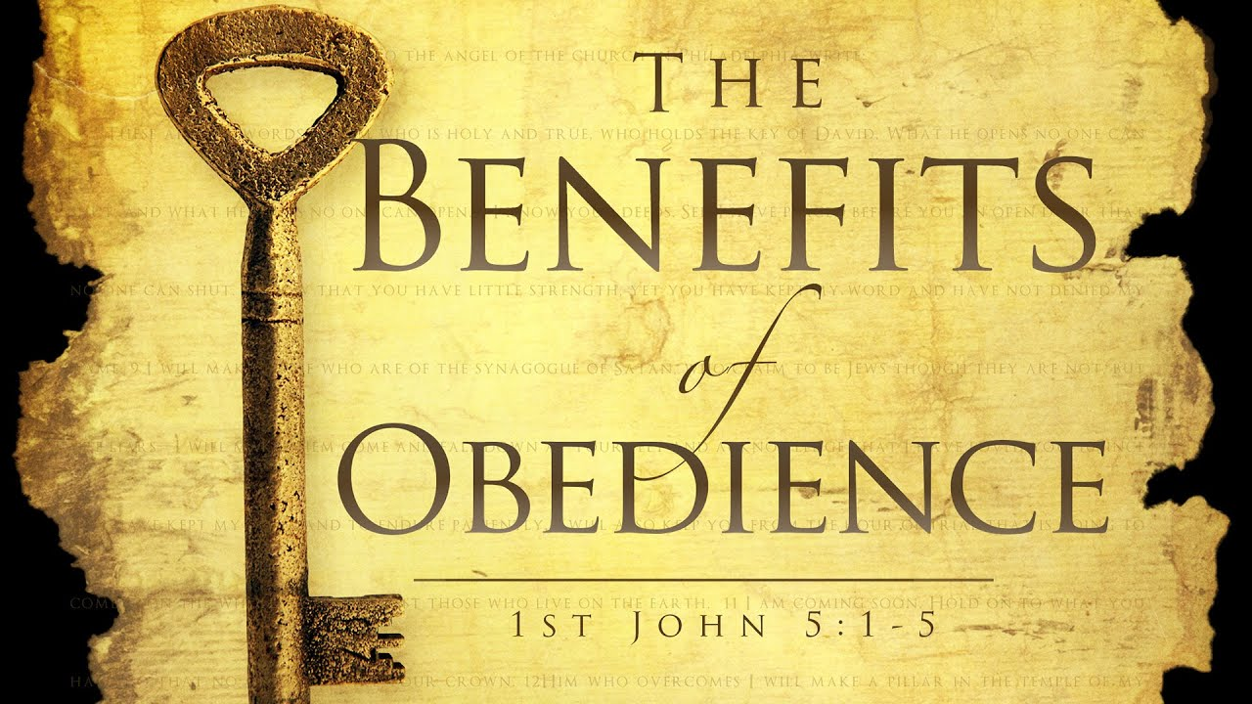

Deut 28:1-14
59
59

Slide 60

Deut 28 Introduction
1 And it shall be, if you diligently obey the voice of Yahuah your Elohim, to guard to do all His commands which I command you today, that Yahuah your Elohim shall set
you high above all nations of the earth.
2 And all these blessings shall come upon
you and overtake you, if you shall obey the voice of Yahuah your Elohim. (TS2009)
60

Slide 61
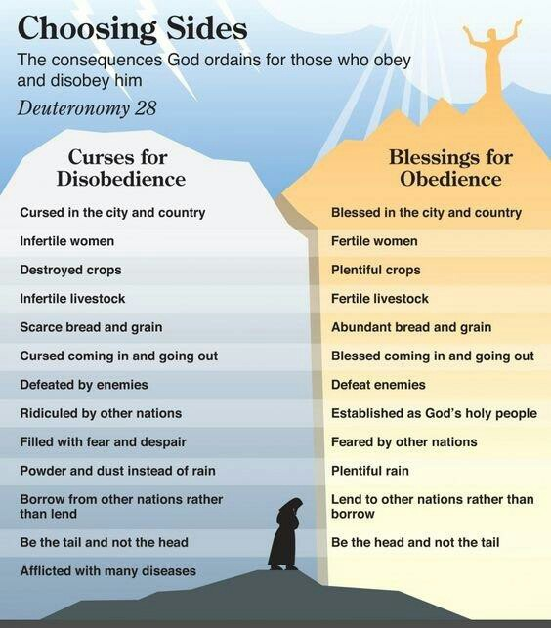


Deut 28 Outline
Blessings for Obedience: vss 1-14
Curses for Disobedience:
vss 15-68
The consequences Yahuah ordains for
those who obey or disobey Him.
Deut 28:13 And Yahuah shall make you the head, and not the tail. And you shall be only on top, and not be beneath, if you obey the commands of Yahuah your Elohim, which I command you today, to guard and do. (TS2009)
Time to examine Jer 23!

Slide 62
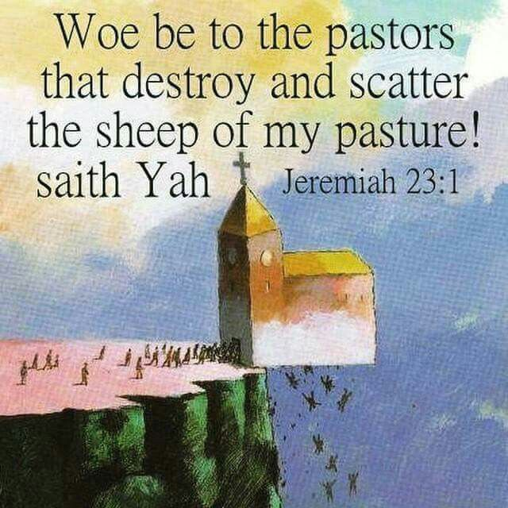
Jeremiah 23:1-8
Woe be to those who are appointed to feed Yah's people, but take no concern to do them good!
Though only a remnant of Yah's flock is left, He will find them out. All the spiritual seed of believing Abraham and praying Jacob shall be protected, and shall be saved from the guilt and dominion of disobedience.
Yahusha’s obedience unto death is the justifying righteousness of believers.
Their sanctification, as the source of all their personal obedience is the effect of their union with Him, and of the supply of His Ruach.
Jeremiah 23 Adapted from Matthew Henry Commentary
62

Slide 63

Jeremiah 23:9-22
The false prophets of Samaria had deluded the Israelites into idolatries;
yet the false prophets of Jerusalem
were guilty of more horrible wickedness, by which the people were made bold to live in continual disobedience.
Today it is even worse!
These false teachers will suffer the most bitter part of the Yahuah's indignation. Why? Because they chose to believe that there was no harm in being disobedient, and practiced accordingly – AND – taught others to follow [as we find in nominal Christianity & most world religions today].
63

Slide 64


Jeremiah 23:9-22 [con’t]
False prophets lead men to be quiet in their disobedience. All those who are resolved to follow in such evil ways, will justly be given up to believe strong delusions.
The time is coming when they will reflect on their folly and unbelief
with remorse because they refused to receive any revelation of Torah, the Prophets, or the Restored Covenant!
Thankfully, the faithful teachings and examples of the true prophets & teachers lead many to repentance, faith, and righteousness.
How many blindly obey authority?
64

Slide 65

Jeremiah 23:23-32
False teachers cannot escape Yahuah's all-seeing eye.
Will they never see what judgments they prepare
for themselves?
There is a vast difference between their false teachings and the “rightly divided” truths found in the Scriptures.
How will the sheep discern?
65

Slide 66

How do the people discern the
Baa’d from the Good if they don’t
know how to rightly divide the truth?

Slide 67

Jeremiah 23:28
The prophet who
has a dream, let him relate the dream,
and he who has My Word, let him speak My Word in “Truth.” “What is the chaff to the wheat?” declares Yahuah. (TS2009)
67

Slide 68

Jeremiah 23:29
Yahuah’s Word is no smooth,
lulling, deceitful message.
The unhumbled heart of man is
like a rock; if it is not melted by
the Word of Yahuah as a fire, it will be broken to pieces as a hammer.
Who can be safe, or at ease, when one lives in direct disobedience to it?
By Yah’s faithfulness and through
His Word, truth may certainly &
easily be distinguished from false doctrines and disobedience of
every false teacher.
68

Slide 69




Is it possible to learn any lessons of obedience from lepers?
69

Slide 70
In the story of 2 Kings 6 & 7, we find trouble in the land of Samaria by the king of Syria. The people inside the besieged
city were definitely starving as were the lepers outside the city.
By a miracle of Yahuah, the Syrians fled leaving behind
all kinds of food surprising even the lepers.
How did the obedient
lepers bless the people
that had discarded them?
70

Slide 71

Some of the Facts for the Lepers:
Times were tough. Samaria was under siege.
People thought they were safe locked behind walls, but they were starving.
The Lepers were considered “unclean” and tossed outside the city.
The Lepers had no choice but to go and look for food or die.
When they looked, food was provided.
The “unclean Lepers” were the ones that brought the good report of
“free food” to those starving inside the walls of the city.
“That day” many people were thankful for the Lepers.
Leper Lesson for all: If you get, give!
71

Slide 72

How Does This Testimony Relate To Us?
Yahuah’s Children Find Bread at the Endtimes
In the endtimes, we will have tough times as well. We may be under siege in a spiritual way.
Christians feel they are safe locked behind the walls of the church.
But, many of them are starving.
Bible students that are finding newly discovered truths are often considered “unclean”
and shunned by fellow church members.
These dear ones have no choice but to go and search for “living bread” or die spiritually.
When they search, Yahuah provides them with the best “bread.”
Although labeled as “unclean” they attempt to share their treasured food with
starving souls in the church.
Unlike the story of the Lepers, many in the churches/fellowships are not thankful
for the “living bread” of the so-called unclean.
Will we be subjected to a “Leper” experience?
72

Slide 73

Counsel from 1 Thess 5
1 But of the times and the seasons, brethren,
ye have no need that I write unto you.
4 But ye, brethren, are not in darkness, that
that day should overtake you as a thief.
7 For they that sleep sleep in the night;
and they that be drunken are drunken in the night.
6 Therefore let us not sleep, as do others;
but let us watch and be sober.
5 Ye are all the children of light, and the
children of the day: we are not of the night, nor of darkness.
Our Lesson: If you learn, teach!
73

Slide 74

74

Slide 75

Highest WORDS of Recommendation
1 Peter 3:15 & Col 4:6
1 Peter 3:15 But sanctify Yahuah in your hearts: and be ready always to give an answer
to every man that asketh you a reason of the
hope that is in you with meekness and fear.
Col 4:6 Let your speech be always with grace, seasoned with salt, that ye may know how ye
ought to answer every man.
75

Slide 76



How easy is it
to share what
you have learned?
Share gently, like Yahusha, remembering everyone has a choice.
76

Slide 77
Share what you have found, but …
Allow the Ruach to Convict!
However do remember: When defending what one considers to be sound Biblical principles, (that are considered as fundamental articles of faith), it is important to use sound Biblical arguments that will endure the highest scrutiny in order to stay in alignment with Torah.
Would the correct timing of the worship statutes qualify as a “fundamental article of faith & obedience” in these last days?
Does that link to following our Master completely – according
to all of His Covenant worship statutes & commands?
77

Slide 78
Counsel from Eph 5:11, 13
What happens when Yahuah’s “obedient” cannot
share “light” with those in “darkness”?
11 And have no fellowship with the unfruitful works of darkness, but rather reprove them.
13 … all things that are reproved are made manifest by the light: for whatsoever doth make manifest is light.
What does it mean to reprove others?
78

Slide 79

79

Slide 80





Yahuah’s Peculiar People Know How To …
80

Slide 81






What have we learned in this study about
Obedience and “rightly dividing the Word of Truth”?
1. Shema/Shama
Means to obey,
and stay obedient.
How? When we “hear”
we will complete the
command by “doing.”
This is the result of “rightly dividing the
Word of Truth” for
.
2. To be Submissive or Obedient?
Everyone has the responsibility
To be Submissive
AND
To be Obedient
3. To Keep or To Guard?
To Keep the commandments means to “Shema” –
to “hear & act accordingly.”
To Guard the commands
means to protect
them at all cost
& pass the Words
intact down through
the generations.
81

Slide 82


A Message to Covenant Calendar Members
The words of Jeremiah 23 declare in vivid expression
what is going on in this world today.
Being willing (inward attitude) and obedient (outward action),
is preparation for Yahuah’s Kingdom.
Friends, STAY CLOSE to our Shepherd, Yahusha.
There is no other choice!
82

Slide 83

And you
will be a
“king” &
“priest”
forever
in His
highest
Malkiy-tsedeq
Priesthood!
83

Slide 84

Let your commitment to truth be so great that any punishment you receive for adhering to “truth” will “give you pleasure.”
Truth does not fight to have a place in the heart of man.
It simply presents itself! TAKE IT or LEAVE IT!
84

Slide 85

Choose to stay on the path of obedience and walk in the Light, for there is no “darkness” in His people, the Bride of Yahusha.
Your friends from Colorado stand with you.
The End
85

